Slide 1


Capstone Project-1

Slide 2
Problem Statement:
▶ For this project we will be analyzing Hotel booking data. This data set contains booking information for the city hotel and resort hotel, and includes information such as when the booking was made, length of stay, the number of adults, children, and/or babies, and the number of available parking spaces.
▶ Hotel industry is a very volatile industry and the bookings depends on above factors and many more.
▶ The main objective behind this project is to explore and analyze data to discover important factors that given the bookings and give insights to hotel management, which can perform various campaigns to boost the business and performance.

Slide 3
Work Flow :
So we will divide our work flow into following 3 steps.
●
Data Collection and Understanding
Data Cleaning and Manipulation
Exploratory Data Analysis(EDA)
EDA will be divided into following 3 analysis.
Univariate analysis: Univariate analysis is the simplest of the three analyses where the data you are analyzing is only one variable.
Bivariate analysis: Bivariate analysis is where you are comparing two variables to study their relationships.
Multivariate anlysis: Multivariate analysis is similar to Bivariate analysis but you are comparing more than two variables.

Slide 4
Data Collection and Understanding:
hotel dataset contains total rows 119390 and 32 columns.in this project we want to look in divide data manipulation workflow in three category Data Collection ,Data cleaning and manipulation and EDA(Exploratory Data Analysis).
Data Description:
hotel :Resort Hotel or City Hotel
is_canceled : Value indicating if the booking was canceled (1) or not (0)
lead_time : Number of days that elapsed between the entering date of the booking and the arrival date
arrival_date_year : Year of arrival date
arrival_date_month : Month of arrival date
arrival_date_week_number : Week number of year for arrival
date arrival_date_day_of_month : Day of arrival date
stays_in_weekend_nights : Number of weekend nights

Slide 5
Data Collection and Understanding:
stays_in_week_nights : Number of week nights.
adults : Number of adults
children : Number of children
babies : Number of babies
meal : Type of meal booked.
country : Country of origin.
market_segment : Market segment designation.
(TA/TO) distribution_channel : Booking distribution
channel.(T/A/TO) is_repeated_guest : is a repeated
guest (1) or not (0)

Slide 6
Data Collection and Understanding:
previous_cancellations : Number of previous bookings that were cancelled by the customer prior to the current booking
previous_bookings_not_canceled : Number of previous bookings not cancelled by the customer prior to the current booking
reserved_room_type : Code of room type reserved.
assigned_room_type : Code for the type of room assigned to the booking.
booking_changes : Number of changes made to the booking from the moment the booking was entered on the
PMS until the moment of check-in or cancellation
deposit_type : No Deposit, Non Refund , Refundable.
agent : ID of the travel agency that made the booking
company : ID of the company/entity that made the booking .
days_in_waiting_list : Number of days the booking was in the waiting list before it was confirmed to the customer

Slide 7
Data Collection and Understanding:
customer_type : type of customer. Contract,Group,transient,Transient party.
adr : Average Daily Rate as defined by dividing the sum of all lodging transactions by the total number of staying nights
required_car_parking_spaces : Number of car parking spaces required by the customer
total_of_special_requests : Number of special requests made by the customer (e.g. twin bed or high floor)
reservation_status : Reservation last status.
After the adding some column in dataframe the another datatype or column is this
total_guest : its show the over all guest with the adding adult, children, and babies.
total_stay_in_nights : the adding of stays_in_week_nights and stays_in_weekend_nights.
revenue : total_stay_in_hotel and ADR with the multiplication we got revenue..

Slide 8
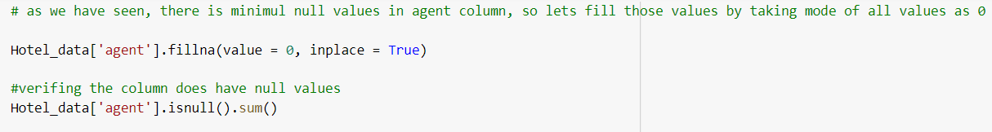
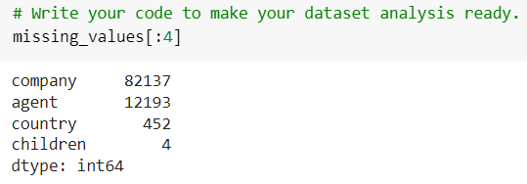
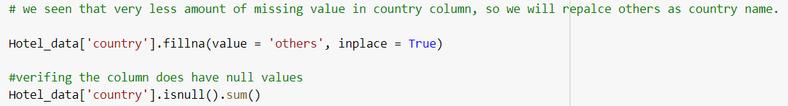
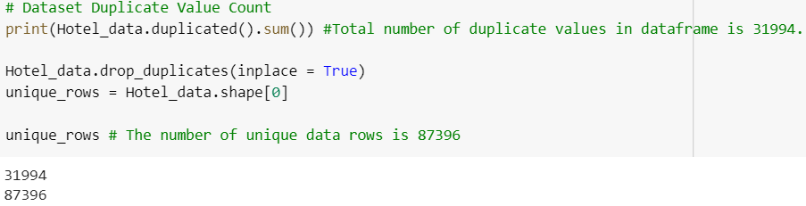
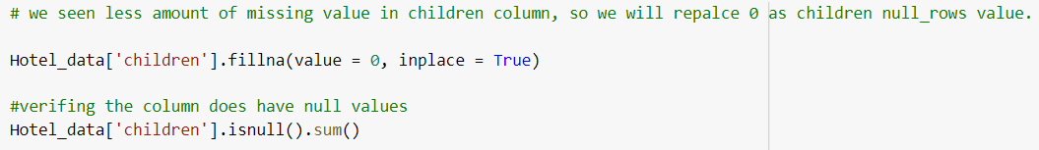
Data Cleaning and Manipulation:
There were 4 columns company, agent, country and children with missing values.
Handling Duplicates: Data had 31994 duplicates values.
So we dropped it from the data.

Slide 9
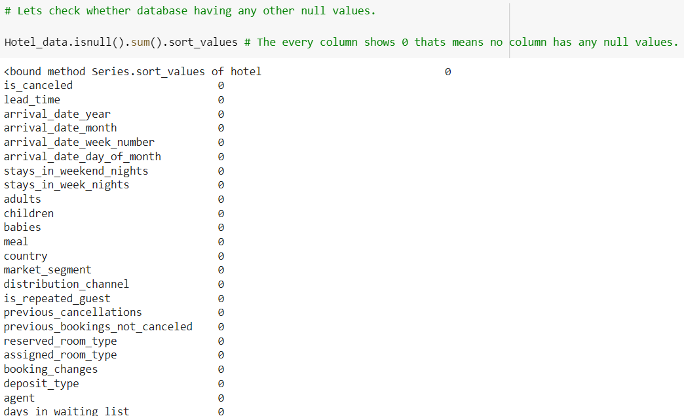
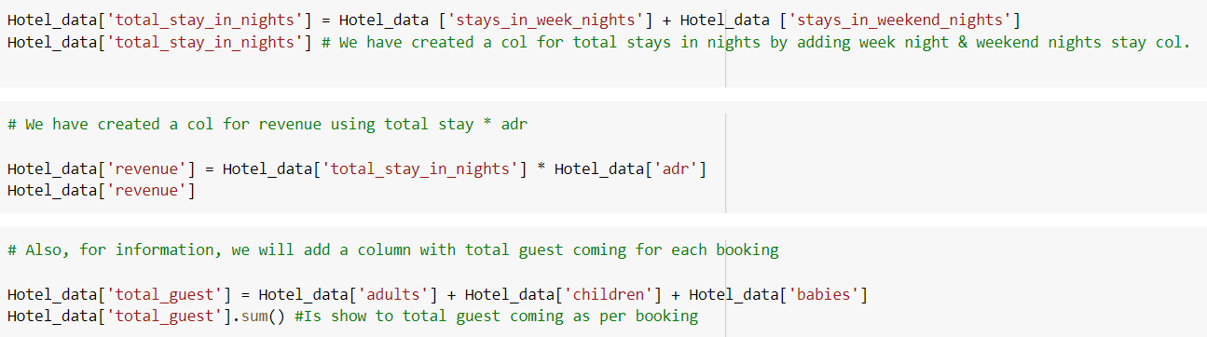
Data Cleaning and Manipulation:
Feature Engineering:
We created 2 new columns
1)‘Total_People’ = from the Children, adults, babies.
2) ‘Total_stay’ = From weekend nights and weekdays night

Slide 10
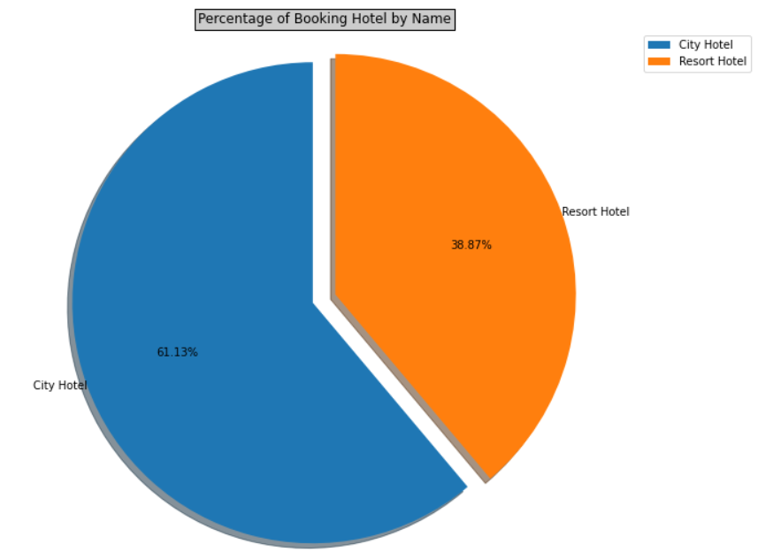
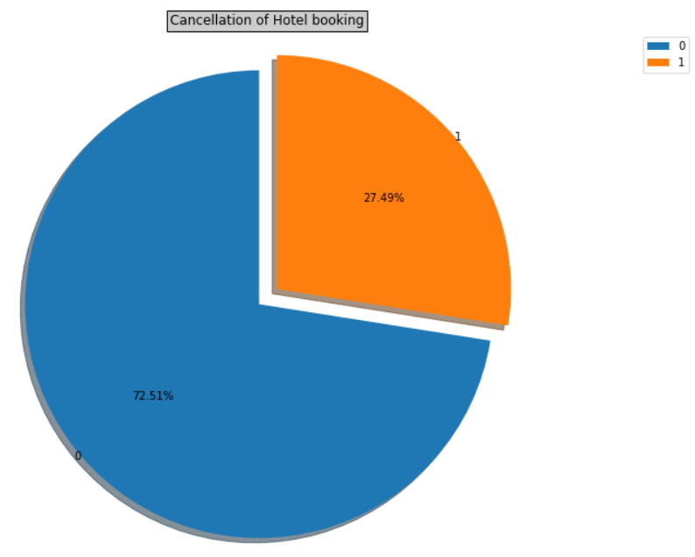
Exploratory Data Analysis (EDA) :
●
Conclusions:
City hotels is the most preferred hotel type by the guests. We can say City hotel is the busiest hotel.
we can see city hotel have 61.13% sales.
27.49% bookings were got cancelled out of all the bookings.

Slide 11
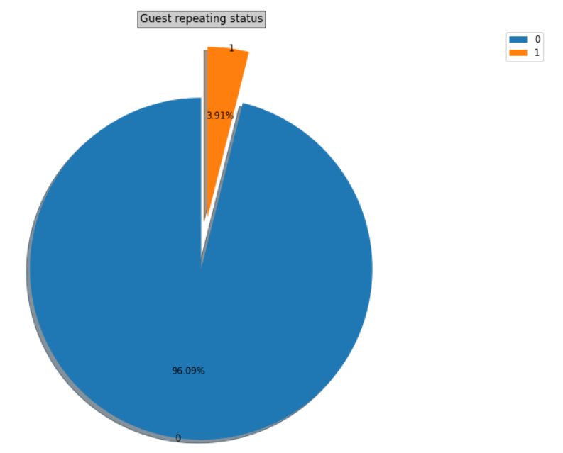
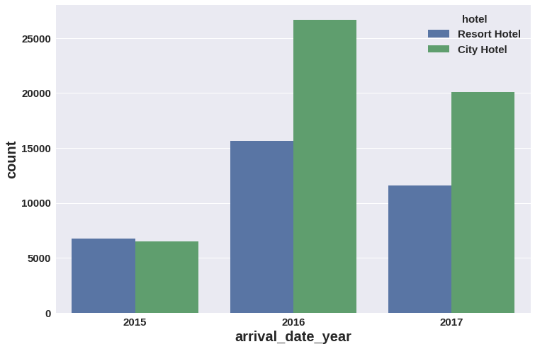
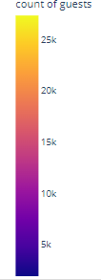
Exploratory Data Analysis (EDA) :
Conclusions:
Maximum guests are new for booking a hotel
Only 3.91% repeated guest are come again to the hotel.
Most of the bookings for City hotels and
Resort hotel were happened in 2016. As we can see Most of the bookings were for City hotels.

Slide 12
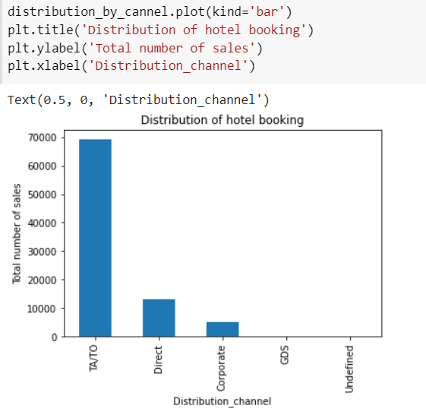
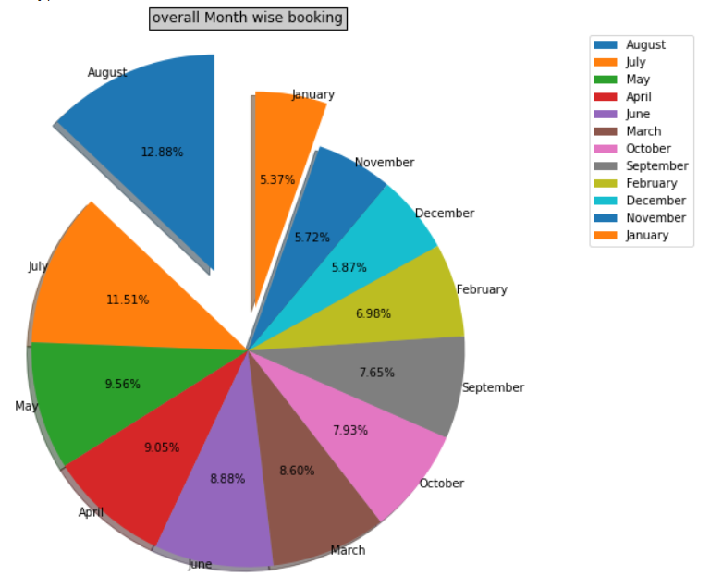
Exploratory Data Analysis (EDA) :
Conclusions:
The percentage of TA/TO highest hotel booking other distribution direct and corporate is less sale compare to TA/TO .TA/TO has sales 69141.
Overall month wise booking show in another graph that shows that maximum booking are held in august , July , may months.

Slide 13
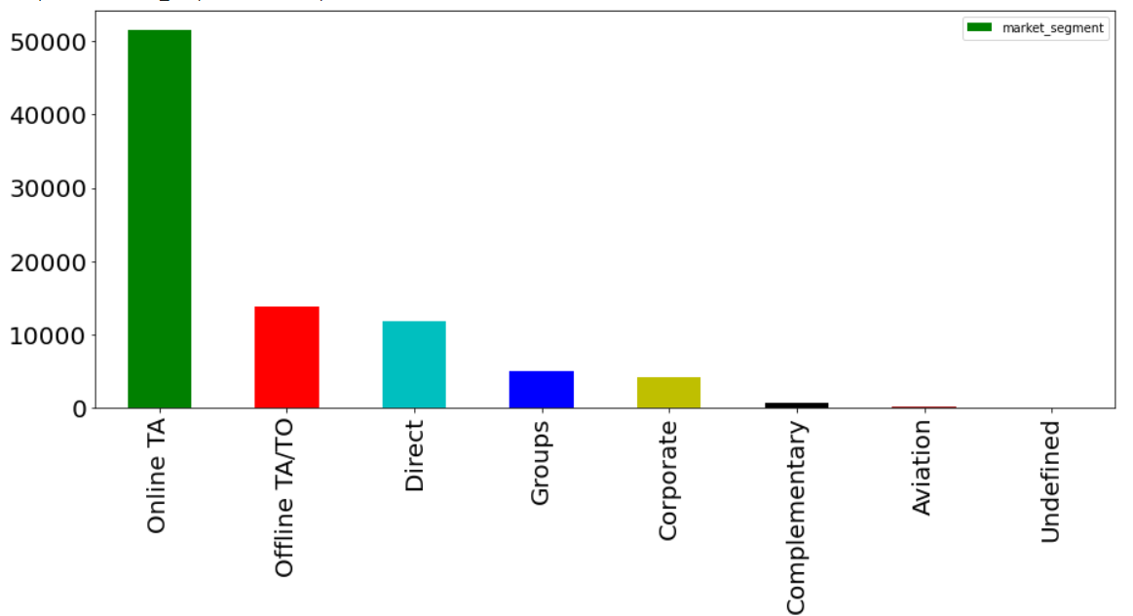
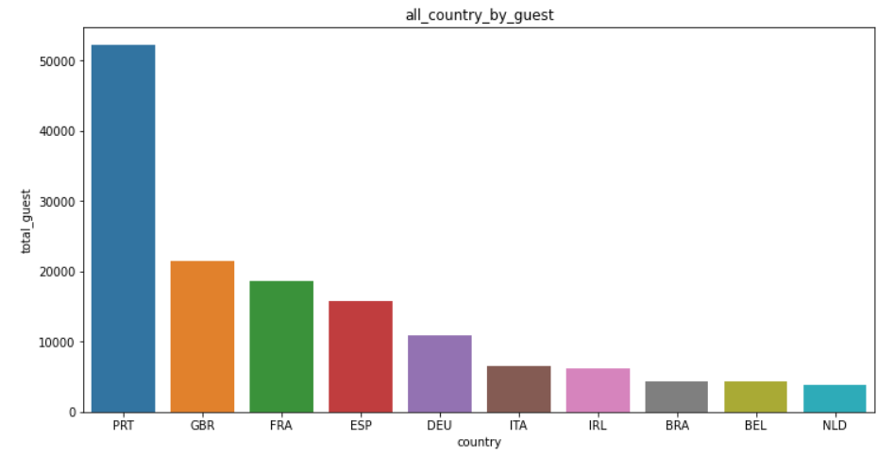
Exploratory Data Analysis (EDA) :
Conclusions:
The percentage of online TA is more higher then other market segmate. Offline TA/TO and direct has same level. The total business given by online TA is 51618
We can see that aviation and undefined has activities in the market.
The other graph I shown that guest by country. Looking as graph we can see that the highest booking is done by Portugal country
We can see that the total number of booking is highest is 52144.

Slide 14
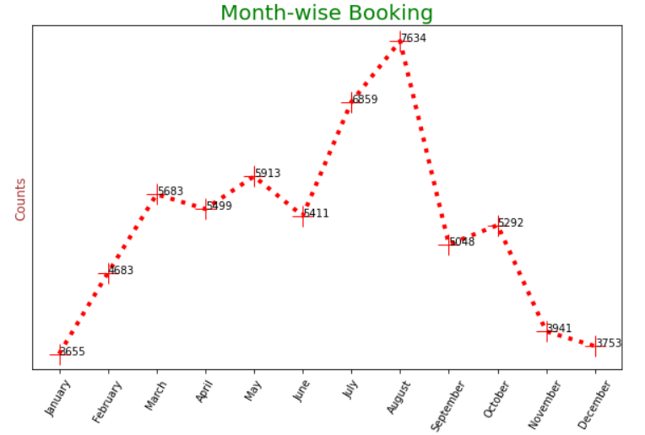
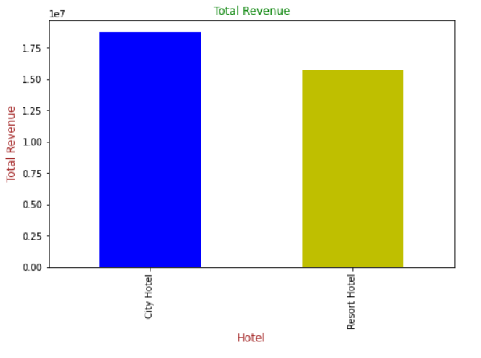
Exploratory Data Analysis (EDA) :
As we can seen in last graph the highest sale of hotel booking in august months.
The year starting and the ending was very poor. Lowest per of booking in the January and December months.
This graphs show that both city and resort hotel total revenue.
As we can see city hotel is must preferred by customer that’s why there is a highest number of revenue.
The total revenue of city hotel is 18774101.54
The total revenue of resort hotel is 15686837.77

Slide 15
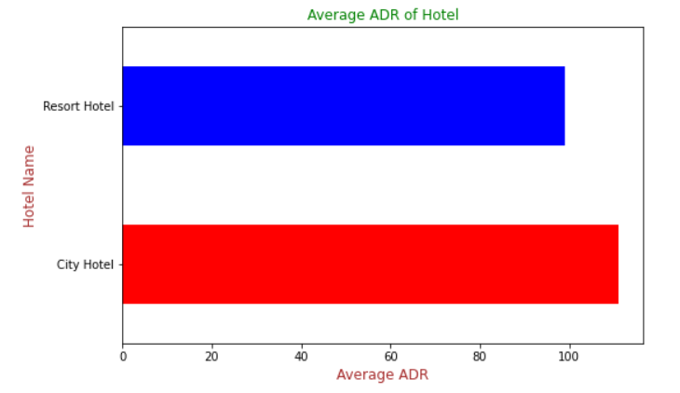
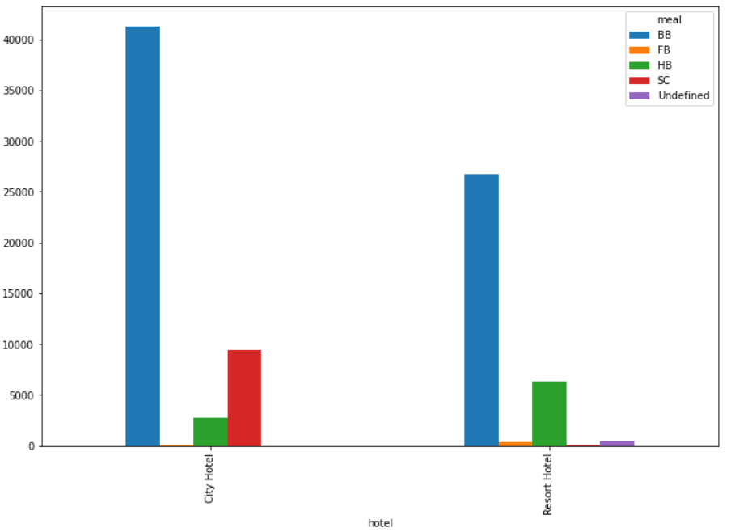
Exploratory Data Analysis (EDA) :
Again the city hotel is have average ADR value in graph. Resort average ADR value is close enough to city ADR.
The total number of city hotel ADR is 110.985944
The total number of resort hotel is 99.025346
The above graph show meal order by the customer
We can see that the city hotel customer has to preferred BB maximum time and SC.
And resort hotel customer also preferred BB and HB.

Slide 16
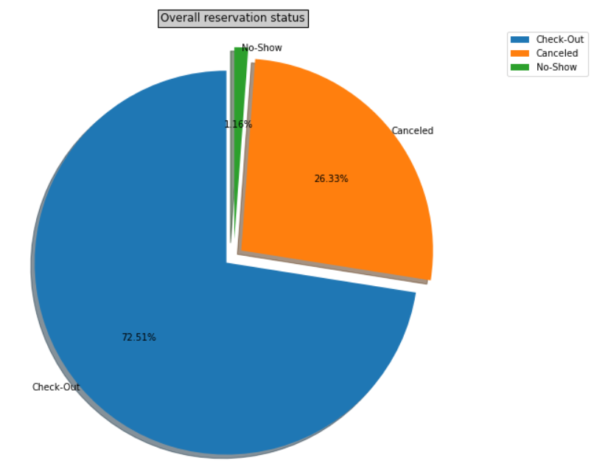
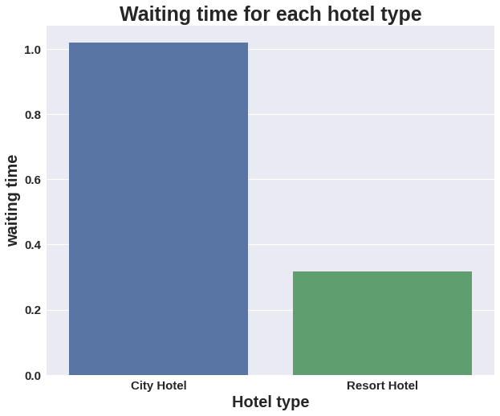
Exploratory Data Analysis (EDA) :
We can see that the above graph show that over all reservation of hotel.
The total confirm booking those are check-out the hotel . That is 72.51%
The cancelation rate is 26.33%
We can see that the above graph show that over all waiting time of hotel.
The total overall waiting time for city hotel 1.0

Slide 17
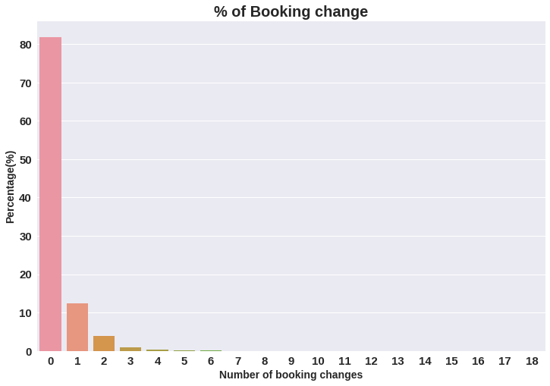
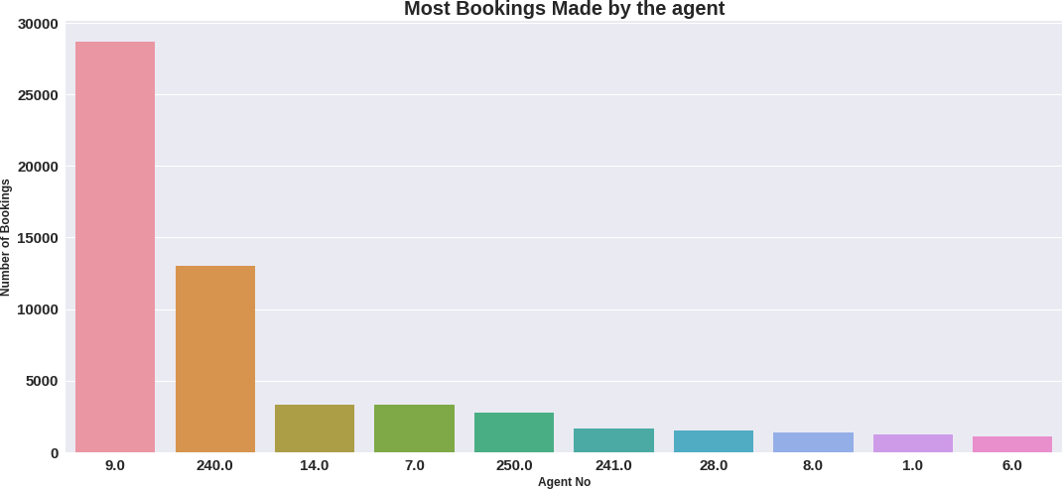
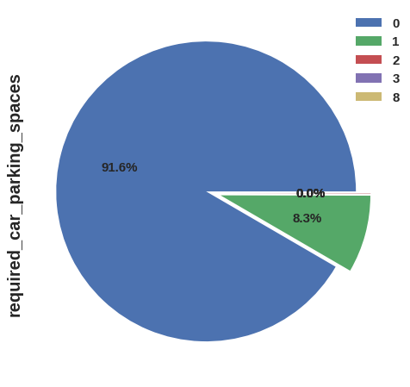
Exploratory Data Analysis (EDA) :
●
Conclusions:
The percentage of 0 changes made in the booking was more than 82 %. Percentage of Single changes made was about 10%.
Agent Id no -9 made the highest bookings which is more than 28721.
Most of the customers(91.6%) do not require car parking spaces. Only 8.3 % people required only 1 car parking space.

Slide 18
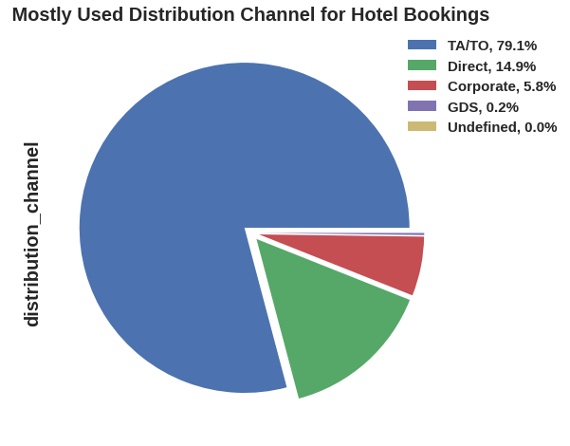
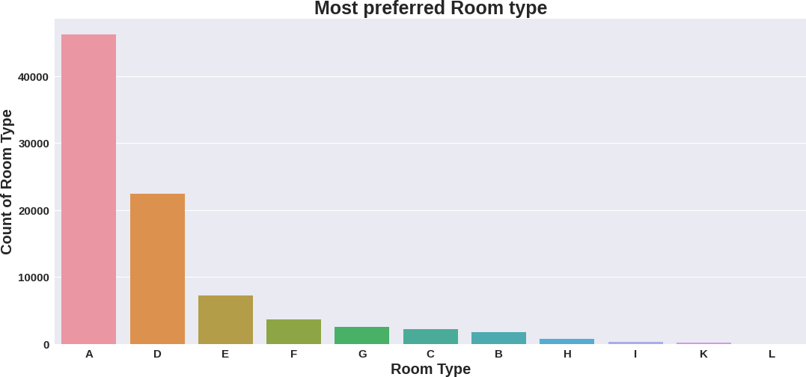
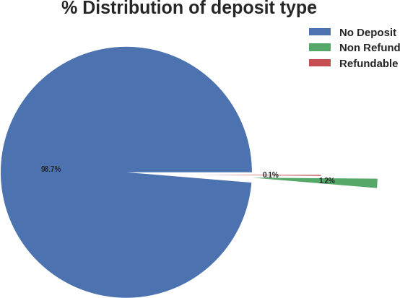
Exploratory Data Analysis (EDA) :
●
Conclusions:
79.1 % bookings were made through TA/TO (travel agents/Tour operators).Second most channel is direct.
Room type ‘A’ is most preferred by the guests second most preferred is ‘D’.
Almost 98.7% of the guests prefer ‘No deposit’ type of criterion while booking hotels.

Slide 19
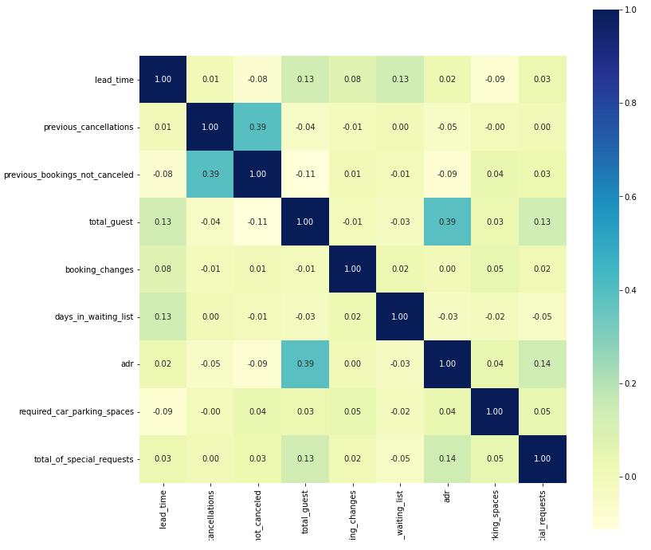
Exploratory Data Analysis (EDA) :

Slide 20
Exploratory Data Analysis (EDA) :
Total stay length and lead time aíe slightly correlated. This may means that for longer hotel stays, people generally plan little before the actual arrival.
To understand the relationship between different numerical values
ADR is slightly correlated with total_people, which makes sense as more no. of people means more service to deliver, therefore more ADR.
Highest corelation value between axis is 39% positive & lowest correlation value between the axis is -9% negative.

Slide 21
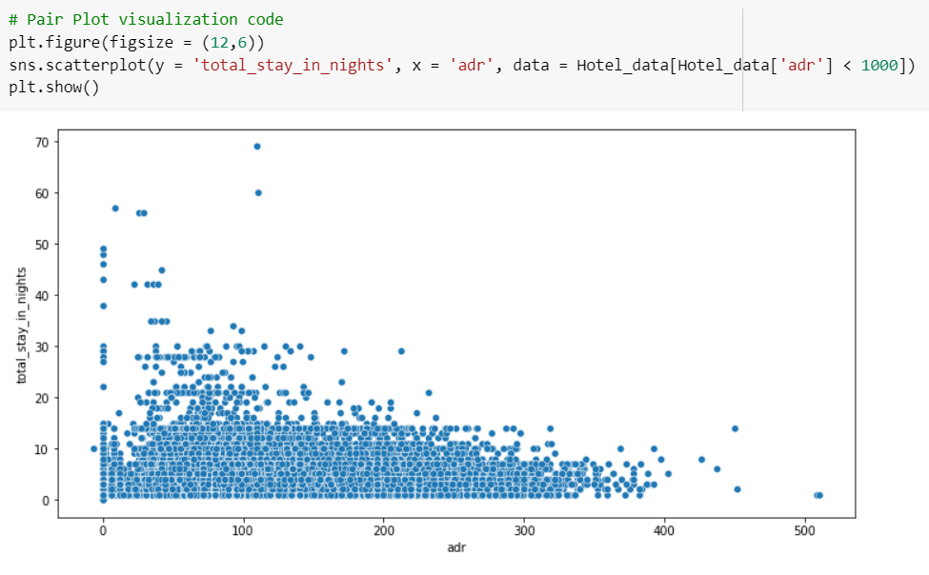
Exploratory Data Analysis (EDA) :

Slide 22
Solution to business Objective:
For hotel business to flourish few things which we need to consider is high revenue generation, customers satisfaction and employee retention.
Increasing the revenue achieved by bar chart distribution of which typre room are most reserved and what are the months likely for visitors
Outliers like higher the visitor then adr has reduced drastically was shown in scattered plot so in off season client can engage with offices for bulk booking this will aslo help extra revenue generation
We are able achieve the same by showing the client which are the months which are high in revenue generation by pie chart distribution
So for these the client can be well prepare in advance so that minimum grievances would be faced by clients in long run and would help in further enhancement of their hospitality.
We where also able to co relate the values showing the max and min percentage between them so that the percentage lying those numbers can be enhanced by various medium
We are able to show the trend of arrivals of visitor at client locations through which client engaged visits well advance for there entertainment and leisure activities
also we can show the trend of meal graph that show the higher sale of meal is B&B
Code Text

Slide 23
Conclusion:
Most number of bookings are made from Portugal & Great Britain.
City Hotel seems to be more preferred among travelers and it also generates more revenue & profit.
Most number of bookings are made in July and August as compared rest of the months.
Room Type A is the most preferred room type among travelers.
Most of the guest stays for 1-4 days in the hotels.
New guest tends to cancel bookings more than repeated customers.
Around one-fourth of the total bookings gets cancelled. More cancellations are from City Hotel.
Lead time, number of days in waiting list or assignation of reserved room to customer does not affect cancellation of bookings.
The length of the stay decreases as ADR increases probably to reduce the cost.
Corporate has the most percentage of repeated guests while TA/TO has the least whereas in the case of cancelled bookings TA/TO has the most percentage while Corporate has the least.

